Slide 1
WELCOME
CLASS OF 2025!

Slide 2
ORIENTATION AGENDA August 16, 2023
I Welcome/Introduction of Faculty/Students
II Classes Fall 2023
III Policies and Procedures (http://cnhs.fiu.edu/csd)
IV Plan of Study
V General Program Information
VI Masters’ Projects and Theses
APPROXIMATE 15 MIN BREAK
VII CAA Accreditation Status
VIII Counseling and Psychological Services
IX Clinical Education
X Record Keeping
XI Forms
XII Advisors
XIII NSSHLA
XIV Q & A/Tour

Slide 3
Adjunct Faculty:
Michele Aurignac
Cindy Simon
Barry Freeman
Joseph Zelenke
Faculty:
Monica Hough, Chair and Professor
Alliete Alfano, Assistant Professor
Angela Medina, Associate Professor
Jean Mead, Clinical Associate Professor
Mariateresa (Teri) Muňoz, Clinical Assistant Professor
Eliane Ramos, Clinical Associate Professor
Chelsea Sommer, Assistant Professor
Office Staff:
Nancy Bradbury, Program Coordinator
Nuria Rodriguez, Coordinator Administrative Services
Moises Noblecilla, Office Assistant OPS
Henry Sardinas, Office Assistant OPS

Slide 4
Classes Fall 2023
All classes will be offered in face-to-face format, unless the particular classes have been approved for a different format.
Fall semester exceptions:
SPA 5935 Pre-Clinic Seminar (Dr. Mead) will be offered in the FIU online LIVE format. Dr. Mead will contact you relative to the organization and format of class.

Slide 5
Classes Fall 2023
SPA 5204 Phonological Disorders (Medina) Thursdays
SPA 5553 Differential Diagnosis of Communication Disorders (Alfano) Tuesdays
SPA 5402 Language Learning in Preschool Children (Ramos) Mondays
SPA 5805 Research Methodology in CSD (Hough) Wednesdays
SPA 5935L Pre-Clinic Seminar (Mead) Fridays

Slide 6
Policies & Procedures
DEPARTMENTAL WEBSITE: http://cnhs.fiu.edu/csd
Important reminders
You must receive a grade of B or better to pass a course
When you receive a grade below B, you are required to retake the course the next time it is offered
DISMISSAL from the Masters program:
failing a course twice OR
GPA <3.0 in 2 semesters OR
Grade below B in more than 2 courses
Lapses in enrollment of more than two semesters will require readmission into the program

Slide 7
Policies & Procedures
PRAXIS (Certification) examination: students will register to take exam next-to-last or last semester in program
Goal: pass the examination the first time you take it
You must pass the praxis examination to graduate

Slide 8
PRAXIS (Cont’d)
When registering to take the PRAXIS exam, you need to make sure you have your PRAXIS scores sent to three entities:
1) CSD Department at FIU (we need a record of you taking the exam for you to graduate;
2) American Speech-Language-Hearing Association (enables you to become a certified SLP; and
3) FLorida Dept. of Health (licensed SLP in State of Florida).
WE WILL REMIND YOU ABOUT THIS AGAIN NEXT YEAR.

Slide 9
Policies & Procedures
Apply for graduation during semester before graduation (separate application for commencement)
You must be enrolled for at least 1 credit in the semester that you plan to graduate
All general education prerequisites must be completed to apply for ASHA certification
Grievances: http://gradschool.fiu.edu/policies_grievance.htm

Slide 10
General Education Prerequisites http://www.asha.org/about/membership-certification/handbooks/slp/slp_standards_new.htm
ASHA Standards: NEED in addition to undergraduate/post-baccalaureate CSD prerequisites:
1 Physical Science (Chemistry or Physics ONLY)
1 Biological Science (Biology, Marine Biology, Animal Biology, General Anatomy & Physiology)
2 Behavioral Sciences (Psychology, Sociology, Anthropology, Social Work)
1 Statistics

Slide 11
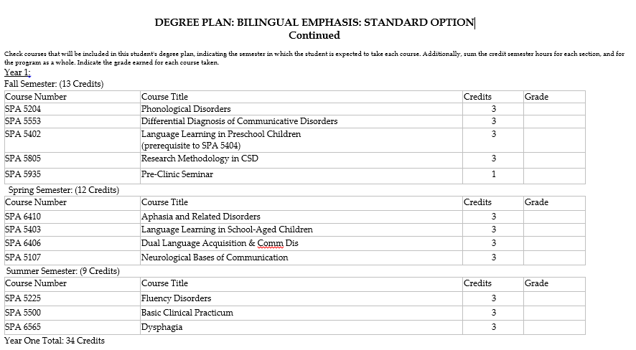
Program of Study: Option I

Slide 12
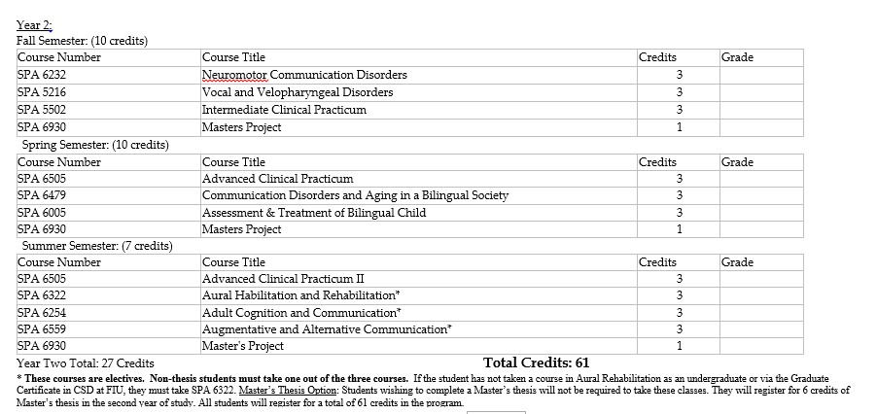

Slide 13
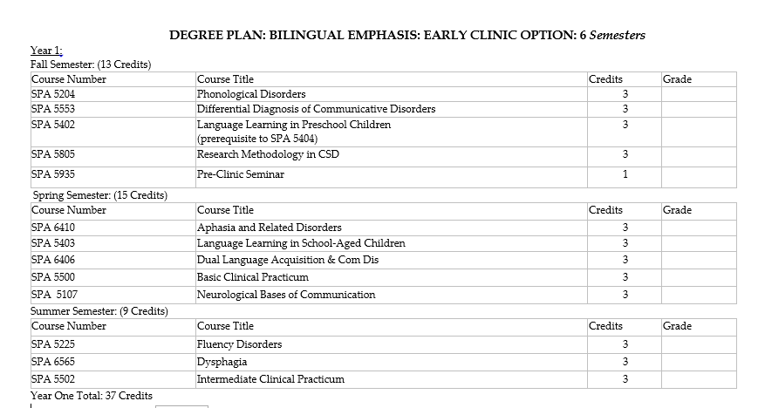
Program of Study: Option II

Slide 14
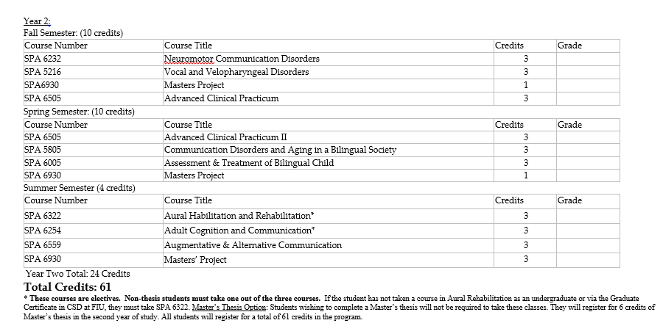

Slide 15
General Program Information
FIU Email Address: Begin using immediately and always login to classes using FIU credentials so attendance reports are accurate.
Working during the Masters’ SLP Program
Class Attendance
CSD website
Student Handbook
Class syllabi

Slide 16
CSD Department Information
SLP MASTERS Degree Plan
Transcripts
Knowledge and Skills Outcome Standards

Slide 17
Masters’ Projects & Theses
Masters’ Project: Conducted During Second Year
Provide students with opportunity to synthesize academic and clinical experiences; participate in completion of DATA-BASED research project within group of 3-5 students with CSD faculty mentor.
Research project topics are based on expertise and interest of faculty mentors.
Student selects a group to work with based on their interest in research project topics and availability.
A particular group of students and their faculty mentor work on the project for 3 semesters from beginning to completion.

Slide 18
Masters’ Projects & Theses
Masters’ Thesis: Conducted During Second Year
Extensive writing-intensive research project in which the individual student conducts a significant experiment in the CSD field. It takes a full year to complete a thesis.
The student reads everything available that relates directly and indirectly to their field of study.
Then, the student progresses to primary research, involve conducting one's own experiment(s) and defending their findings in an oral forum.

Slide 20
CAA Accreditation Status
Council on Academic Accreditation for Audiology and Speech-Language Pathology (CAA) of the American Speech-Language-Hearing Association
Accrediting body for SLP and AuD clinical graduate programs throughout USA
FIU Masters’ SLP is an accredited program, currently accredited through 11/30/2024
SO: CSD Department faculty will begin preparing for the RE-ACCREDITATION process THIS year!

Slide 21
Counseling & Psychological Services
Student Health Center (SHC) 270
305-348-2277(CAPS)
http://www.caps.fiu.edu
Disability Services
Mindfulness Research Lab

Slide 22
Civility and Respect
Civility is an essential component of FIU core values and includes all meetings and classroom behavior.
When both faculty and students model civility, it contributes to the growth of individuals.
Students are encouraged to comment, question, or critique ideas, but never attack a faculty member or another student; respect is pivotal to all interactions.
Students are discouraged from checking text messages, social media, playing games on a computer/phone, or carrying on conversations while instructors are lecturing or classmates are presenting.

Slide 23
Clinical Education
Clinical Rotations (early vs. standard)
Reliable transportation
Clinical Expectations

Slide 24
Clinical Education
American Databank
FIU SLP Scrubs
CALIPSO/ Clinical Documentation

Slide 25
Record Keeping
Check FIU email regularly (check junk mailbox too)
ALWAYS use your FIU email for department correspondence
Student Mailboxes outside AHC3-435

Slide 26
FORMS
Attestation
Consent & Release Criminal Background Check
Publications Model and Release
Contact Information
Complete these forms (folder) and turn in before leaving today.

Slide 28
NSSHLA: National Student Speech-Language-Hearing Association, FIU Chapter
FIU Officers
President: Chantal Murrell (email: cmurr050@fiu.edu)
Vice President: Stephanie Cabrera and Michelle Alpizar
Social Media Coordinator: Mabel Aday
Treasurer: Elisa Lezcano
CSO Representative: Stephanie Delvalle

Slide 29
THANK YOU
HAVE A WONDERFUL YEAR!

