Slide 1
Welcome
Class of 2026!
FIU MS-SLP
Orientation 2024

Slide 2
​
I Welcome/Introduction of Faculty/Students ​
II Classes Fall 2024 ​
III Policies and Procedures (http://cnhs.fiu.edu/csd) ​
IV Plan of Study ​
V General Program Information ​
VI Masters’ Projects and Theses ​
APPROXIMATE 15 MIN BREAK ​
VII CAA Accreditation Status ​
VIII Counseling and Psychological Services ​
IX Clinical Education ​
X Record Keeping ​
XI Forms ​
XII Advisors ​
XIII NSSHLA ​
XIV Q & A/Tour
Orientation Agenda

Slide 3
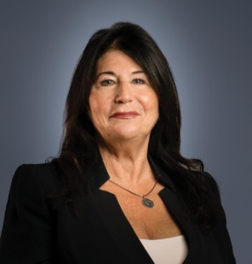
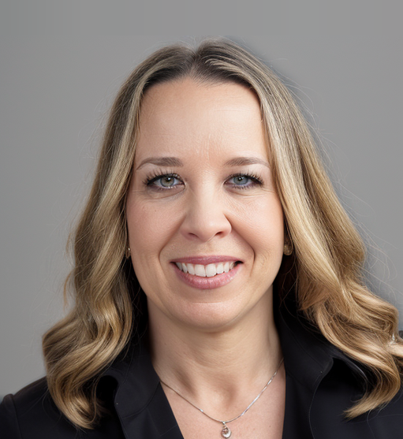
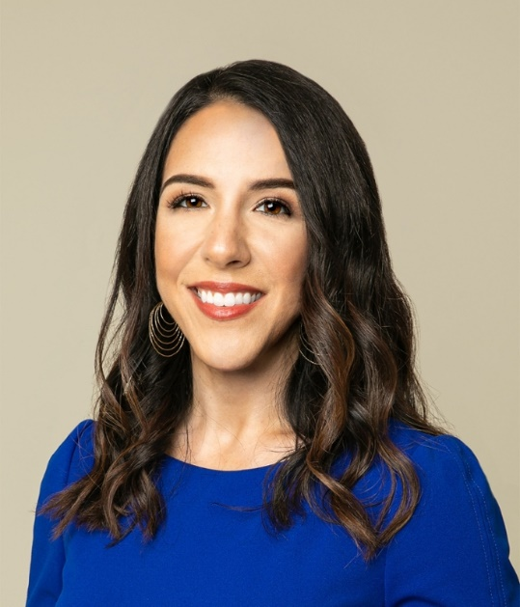
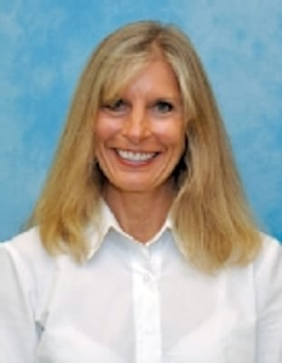
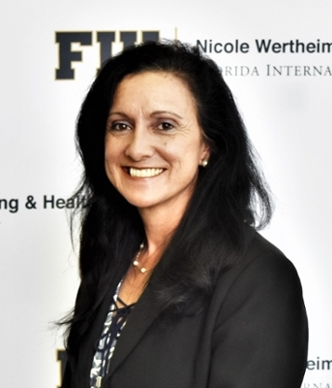
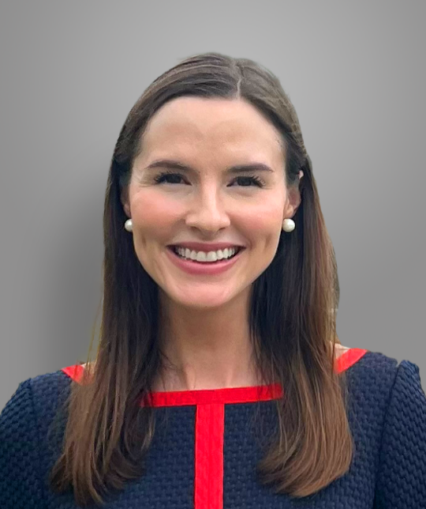
Meet Our Faculty
Dr. Monica Hough
Dr. Aliette Alfano
Dr. Angela Medina
Dr. Jean Mead
Dr. Mariateresa (Teri) Muñoz
Dr. Chelsea Sommer
Dr. Stacey Pavelko
Dept. Chair
Professor
Assistant Professor
Associate Professor
Clinical Associate Professor
Clinical Associate Professor
Assistant Professor
Associate Professor

Slide 4
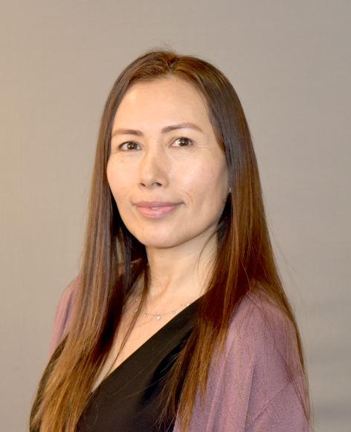
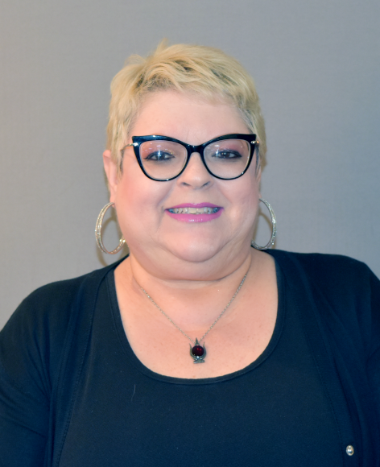
Adjunct Faculty & Office Staff
Michelle Aurignac
Cindy Simon
Barry Freeman
Nancy Bradbury
Nuria Rodriguez
Joseph Zelenke
Program Coordinator
Coordinator Administrative Services​

Slide 6
Classes 2024
Fall semester exceptions:​
Class Formats
All classes will be offered in face-to-face format, unless the particular classes have been approved for a different format.
SPA 5935 Pre-Clinic Seminar (Dr. Mead) will be offered in the FIU online LIVE format. Dr. Mead will contact you relative to the organization and format of class.​

Slide 7
Classes Fall 2024
SPA 5204 Phonological Disorders (Munoz)
SPA 5553 Differential Diagnosis of Communication Disorders (Alfano)
SPA 5107 Neurological Bases of Communication (Zelenke)
SPA 5402 Language Learning in Preschool Children (Pavelko)
SPA 5805 Research Methodology in CSD (Hough)
SPA 5935L Pre-Clinic Seminar (Mead)

Slide 8
Important reminders​:
You must receive a grade of B or better to pass a course ​
When you receive a grade below B, you are required to retake the course the next time it is offered​
DISMISSAL from the Masters program: ​
Failing a course twice OR​
GPA < 3.0 in 2 semesters OR​
Grade below B in more than 2 courses​
Lapses in enrollment of more than two semesters will require readmission into the program​
Policies & Procedures​
Departmental Website: http://cnhs.fiu.edu/csd​

Slide 9
Policies & Procedures​
PRAXIS (Certification) examination: Students will register to take exam next-to-last or last semester in program​
​
Goal: pass the examination the first time you take it​
​
You must pass the praxis examination to graduate
Departmental Website: http://cnhs.fiu.edu/csd​

Slide 10
When registering to take the PRAXIS exam, you need to make sure you have your PRAXIS scores sent to three entities:​
1) CSD Department at FIU (we need a record of you taking the exam for you to graduate;​
2) American Speech-Language-Hearing Association (enables you to become a certified SLP; and ​
3) Florida Dept. of Health (licensed SLP in State of Florida).​
​
Policies & Procedures​
Departmental Website: http://cnhs.fiu.edu/csd​
WE WILL REMIND YOU ABOUT THIS AGAIN NEXT YEAR.​

Slide 11
Apply for graduation during semester before graduation (separate application for commencement)​
You must be enrolled for at least 1 credit in the semester that you plan to graduate​
All general education prerequisites must be completed to apply for ASHA certification​
​
Grievances: http://gradschool.fiu.edu/policies_grievance.htm
Policies & Procedures​
Departmental Website: http://cnhs.fiu.edu/csd​

Slide 12
ASHA Standards: NEED in addition to undergraduate/post-baccalaureate CSD prerequisites: ​
1 Physical Science (Chemistry or Physics ONLY)​
1 Biological Science (Biology, Marine Biology, Animal Biology, General Anatomy & Physiology)​
2 Behavioral Sciences (Psychology, Sociology, Anthropology, Social Work)​
1 Statistics
General Education Prerequisites
http://www.asha.org/about/membership-certification/handbooks/slp/slp_standards_new.htm ​

Slide 13
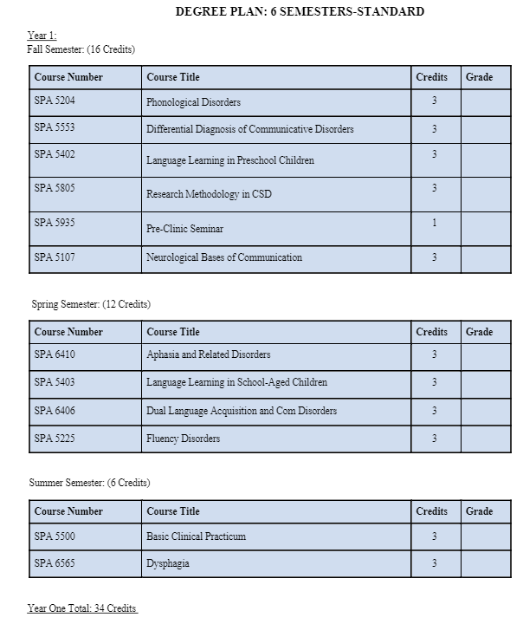
Program of Study (Option 1)

Slide 14
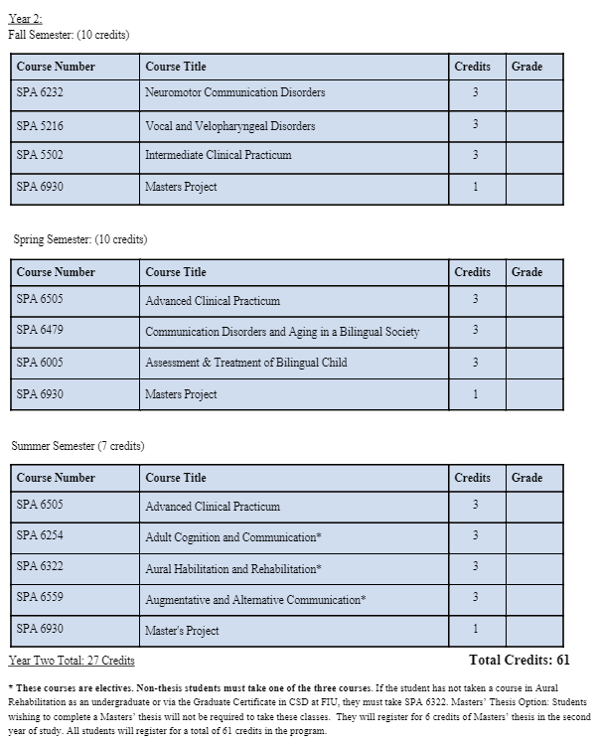
Program of Study (Option 1)

Slide 15
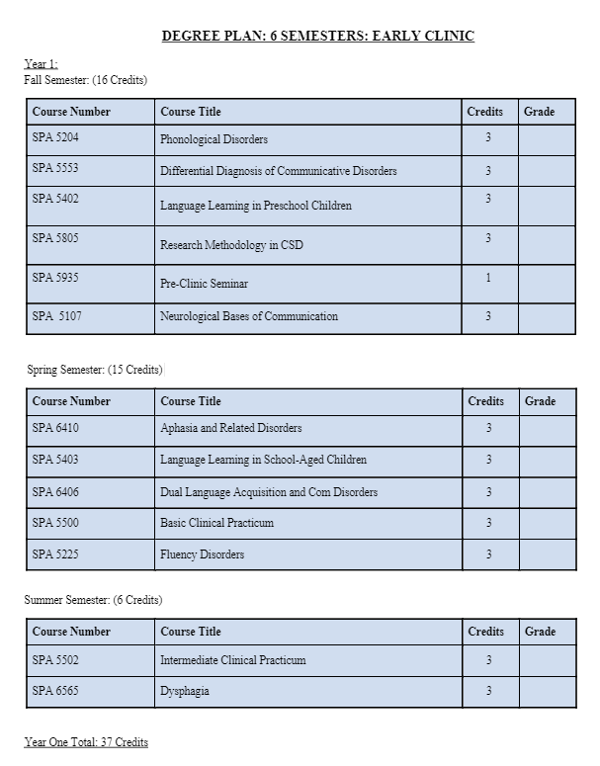
Program of Study (Option 2)

Slide 16
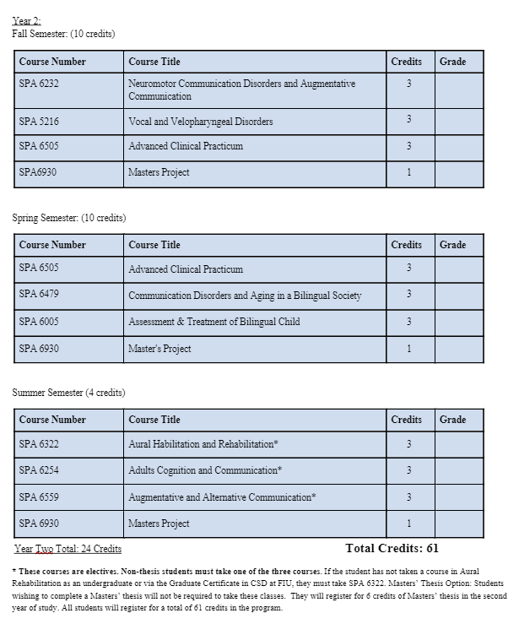
Program of Study (Option 2)

Slide 17
FIU Email Address: Begin using immediately and always login to classes using FIU credentials so attendance reports are accurate.
​
Working during the Masters’ SLP Program​
Class Attendance​
CSD website​
Student Handbook​
Class syllabi
General Program Information

Slide 18
​
CSD Department Information​
​
SLP MASTERS Degree Plan​
Transcripts​
Knowledge and Skills Outcome Standards

Slide 19
Masters’ Projects​
Conducted During Second Year
Provide students with opportunity to synthesize academic and clinical experiences; participate in completion of DATA-BASED research project within group of 3-5 students with CSD faculty mentor.
Research project topics are based on expertise and interest of faculty mentors.
A particular group of students and their faculty mentor work on the project for 3 semesters from beginning to completion. ​
Student selects a group to work with based on their interest in research project topics and availability.

Slide 20
Masters’ Thesis
Conducted During Second Year
Extensive writing-intensive research project in which the individual student conducts a significant experiment in the CSD field. It takes a full year to complete a thesis.
Then, the student progresses to primary research, involve conducting one's own experiment(s) and defending their findings in an oral forum.
The student reads everything available that relates directly and indirectly to their field of study.

Slide 22
Accrediting body for SLP and AuD clinical graduate programs throughout USA​
FIU Masters’ SLP is an accredited program, currently accredited through 11/30/2024​
SO: CSD is currently going through the re-accreditation process. We have submitted our documentation and the actual on-campus site visit is scheduled for Monday and Tuesday, September 23-24.
CAA Accreditation Status​
Council on Academic Accreditation for Audiology and Speech-Language Pathology (CAA) of the American Speech-Language-Hearing Association​

Slide 23
What is expected of ME during the site visit?
Look professional!
​
A group meeting of your cohort will be scheduled with the site visitors sometime during those two days, Be prepared to attend.
​
Be prepared to answer site visitor questions:​
They may ask you if you know what CAA is​
They may ask if you know what to do if you have a accreditation complaint about the program: you would report it directly to CAA.
Council on Academic Accreditation in Audiology and Speech-Language Pathology American Speech-Language-Hearing Association​
2200 Research Boulevard, #310​
Rockville, Maryland 20850​
800-498-2071 or 301-296-5700.

Slide 24
Student Health Center (SHC) 270​
305-348-2277(CAPS)​
http://www.caps.fiu.edu
​
Disability Services
​
Mindfulness Research Lab
Counseling & Psychological Services​

Slide 25
Civility and Respect​
When both faculty and students model civility, it contributes to the growth of individuals.​
Students are encouraged to comment, question, or critique ideas, but never attack a faculty member or another student; respect is pivotal to all interactions.​​
Students are discouraged from checking text messages, social media, playing games on a computer/phone, or carrying on conversations while instructors are lecturing or classmates are presenting. ​
Civility is an essential component of FIU core values and includes all meetings and classroom behavior.

Slide 26
Clinical Education
Clinical Expectations
Reliable Transportation

Slide 27
Clinical Education
American Databank
FIU SLP Scrubs
CALIPSO/ Clinical Documentation​

Slide 28
Check FIU email regularly (check junk mailbox too) ​
​
ALWAYS use your FIU email for department correspondence​
​
Student Mailboxes in cabinet outside AHC3-435 ​
​
Recordkeeping

Slide 29
Attestation
Consent & Release Criminal Background Check ​
Forms
Publications Model and Release ​
Complete these forms (folder) and turn in before leaving today.
Contact Information

Slide 30
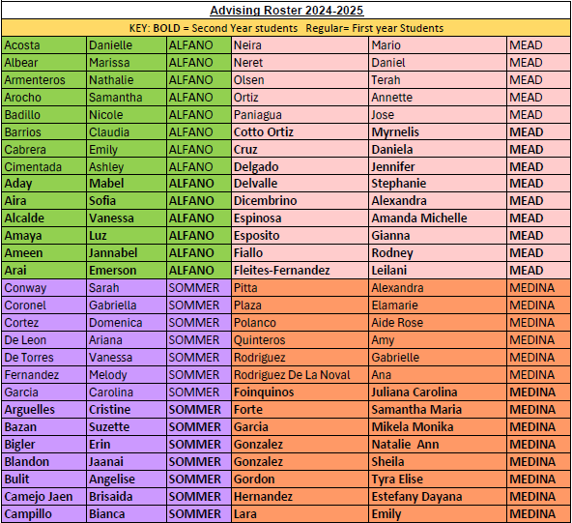
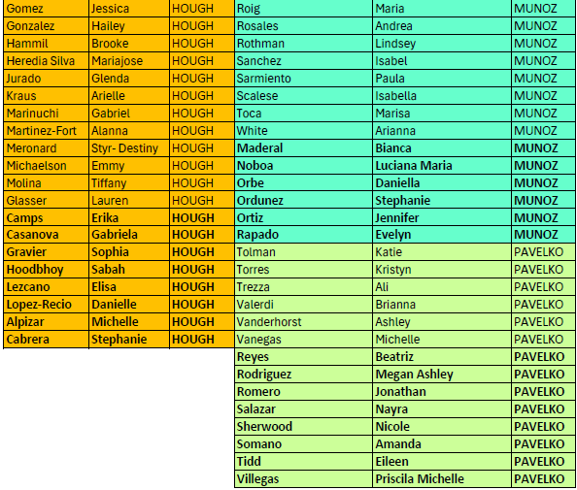
Student Advising and their Advisors

Slide 31
FIU Officers​
​
President: Jannabel Ameen
(email: jamee001@fiu.edu)
​
Vice President: Stephanie Delvalle and Mabel Aday​
​
Social Media Coordinator: Suzette Bazan​
​
Treasurer: Daniela Cruz​
​
CSO Representative: Vanessa Alcalde​
Secretary: Isabella Ovies Morales
Departmental Advisor: Dr. Alliete Alfano
NSSHLA: National Student Speech-Language-Hearing Association
FIU Chapter​

Slide 32
THANK YOU​
HAVE A WONDERFUL YEAR!

