Slide 1
WELCOME
CLASS OF 2025!

Slide 2
Nicole Wertheim College of Nursing and Health Sciences
Department of Communication Sciences & Disorders
Faculty:
Monica Hough, Chair and Professor
Alliete Alfano, Assistant Professor
Angela Medina, Associate Professor
Jean Mead, Clinical Associate Professor
Mariateresa (Teri) Muňoz, Clinical Assistant Professor
Stacey Pavelko, Associate Professor
Chelsea Sommer, Assistant Professor
Adjunct Faculty:
Michele Aurignac
Cindy Simon
Joseph Zelenke
Barry Freeman
Office Staff:
Nancy Bradbury, Program Coordinator
Nuria Rodriguez, Coordinator Administrative Services

Slide 3
Masters’ Projects & Theses
Masters’ Project: PLEASE READ THE SYLLABUS!!!
Provide students with opportunity to synthesize academic and clinical experiences and participate in completion of a DATA-BASED research project within group of 3-5 students with CSD faculty mentor.
Research project topics based on expertise and interest of the faculty mentors.
Groups have been selected based on interest in research project topics and availability.
Each group and their faculty mentor work on project for 3 semesters from beginning to completion.

Slide 4
Masters Projects/Theses
Theses: PLEASE READ THE SYLLABUS! (ASK DR. Hough for it if you haven’t received it.
Meet with your thesis director if you haven’t as yet and identify your thesis committee
Meeting will be scheduled with Thesis directors and students in the near future via ZOOM/F2F

Slide 5
Conducting Research
All Masters SLP students conducting Research must complete:
CITI TRAINING
Collaborative Institutional Training Initiative
https://www.citiprogram.org
If not completed, must complete no later than September 30, 2024
IRB (Institutional Review Board): Documentation specific to your individual/group study. Implemented by the Faculty Director of your project.

Slide 6
Counseling & Psychological Services
Student Health Center (SHC) 270
305-348-2277(CAPS); http://www.caps.fiu.edu
Disability Resource Center
Mindfulness Research Lab

Slide 7
Civility and Respect
Civility is an essential component of FIU core values and includes all meetings and classroom behavior.
When both faculty and students model civility, it contributes to the growth of individuals.
Students are encouraged to comment, question, or critique ideas, but never attack a faculty member or another student; respect is pivotal to all interactions.
Students are discouraged from checking text messages, social media, playing games on a computer/phone, or carrying on conversations while instructors are lecturing or classmates are presenting.

Slide 8
General Education Prerequisites
NEED in addition to undergraduate/post-baccalaureate CSD prerequisites:
1 Physical Science (Chemistry or Physics ONLY)
1 Biological Science (Biology, General Anatomy and Physiology, Animal Biology, Marine Biology)
2 Behavioral Science (Psychology, Sociology, Anthropology, Social Work)
1 Statistics

Slide 9
Accrediting body for SLP and AuD clinical graduate programs throughout USA​
FIU Masters’ SLP is an accredited program, currently accredited through 11/30/2024​
SO: CSD is currently going through the re-accreditation process. We have submitted our documentation and the actual on-campus site visit is scheduled for Monday and Tuesday, September 23-24.
CAA Accreditation Status​
Council on Academic Accreditation for Audiology and Speech-Language Pathology (CAA) of the American Speech-Language-Hearing Association​

Slide 10
Look professional!
​
A group meeting involving all MS SLP students will be scheduled with the site visitors towards the end of DAY1. Be prepared to attend, IF YOU CAN.
​
Be prepared to answer site visitor questions:​
They may ask you if you know what CAA is​
They may ask if you know what to do if you have a accreditation complaint about the program: you would report it directly to CAA.
What is expected of ME during the site visit?
Council on Academic Accreditation in Audiology and Speech-Language Pathology American Speech-Language-Hearing Association​
2200 Research Boulevard, #310​
Rockville, Maryland 20850​
800-498-2071 or 301-296-5700.

Slide 11
PRAXIS/PRAXIS PREPARATION
PRAXIS (Certification) examination: register to take exam next-to-last or last semester in program
Goal is to pass the examination the first time you take it
You must pass the praxis examination to graduate

Slide 12
PRAXIS/PRAXIS PREPARATION
When registering to take the PRAXIS exam, you need to make sure you have your PRAXIS scores sent to three entities:
1) CSD Department at FIU (we need a record of you taking the exam for you to graduate;
2) American Speech-Language-Hearing Association (enables you to become a certified SLP; and
3) Florida Dept. of Health (licensed SLP in State of Florida).

Slide 13
PRAXIS PREPARATION MATERIALS
1) Praxisprep.com
-Has numerous tests for practice.
-Sign up to get up to date information.
2) Therapy Ed
-National Speech-Language Pathology Examination Review & Study Guide (Lof and Johnson)
-study guide in CSD office
3) EZ PRAXIS Preparation Tutors
-praxis slp - praxis 5331 - praxis speech language pathology - praxis slp tutors
Online Tutoring Provider for the PRAXIS in Speech-Language Pathology.

Slide 14
PRAXIS PREPARATION MATERIALS
4) Mometrix Media LLC: SLP Praxis II preparation
-praxis study guide
-sent to you by Dr. Mead
5) National SLP Praxis Review guides
-in the department office
6) ETS The Praxis Study Companion Speech-Language Pathology
-ETS.org
FRIPTY
https://fripty.com/courses/fripty-slp-praxis-study-bundle/

Slide 15
Graduation
Apply for graduation during semester before graduation (separate application for commencement)
You must be enrolled for at least 1 credit in the semester that you plan to graduate
All general education prerequisites must be completed to apply for ASHA certification
Dr. Hough will be unable to digitally sign ASHA certification paperwork upon posting of your degree if:
You have not completed all general education courses
You do not meet (virtually is fine) with her to close your academic file.

Slide 16
Financial Aid Summer 2025
FOR STUDENTS DEPENDENT UPON FINANCIAL AID:
You must be registered for 5 credits to receive federal financial aid during the summer
However, those of you who have done early clinic and are Masters Project students will be registered for only 4 credits during Summer 2025.
SO: IF YOU REQUIRE FINANCIAL AID, THIS IS WHAT WE DO:
You will not register for Masters Project during Spring 2025 and instead register for two credits of Masters Project for Summer 2025
Thus, you will then have 5 credits to register for during the summer.
IT IS IMPERATIVE THAT YOU INFORM ME THAT YOU ARE DOING THIS BEFORE THE SPRING SEMESTER BEGINS

Slide 17
General Program Information
Working During the Second Year of Masters’ SLP Program
CSD website
Graduate Student Handbook
Summer 2025 classes
If you haven’t taken Aural Rehabilitation in undergraduate or in Graduate Certificate program (SPA 6322), you MUST take this course
If you have taken Aural Rehabilitation, you can choose between the three elective courses, SPA 6254 Adult Cognition and Communication, SPA 6559 AAC, SPA 6554 Counseling in Communication Disorders. There will be caps on enrollment for these classes.

Slide 18
INTERNSHIPS/PLACEMENTS
Materials for check-out
Mentor-Mentee
CALIPSO
Scrubs

Slide 19
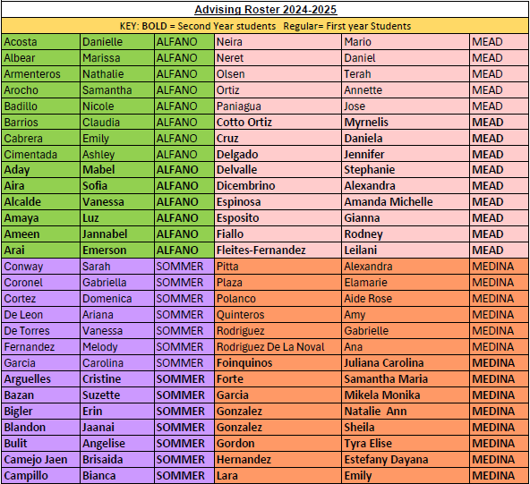
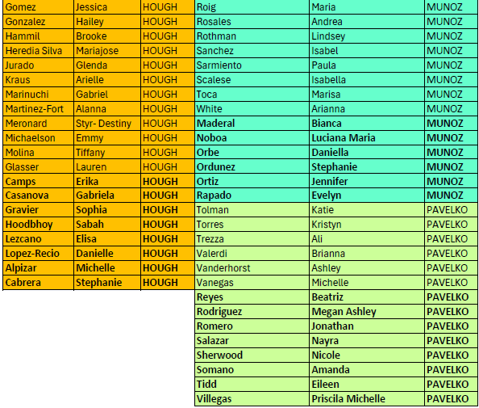
Student Advising and their Advisors

Slide 20
FIU Officers​
​
President: Jannabel Ameen
(email: jamee001@fiu.edu)
​
Vice President: Stephanie Delvalle and Mabel Aday​
​
Social Media Coordinator: Suzette Bazan​
​
Treasurer: Daniela Cruz​
​
CSO Representative: Vanessa Alcalde​
Secretary: Isabella Ovies Morales
Departmental Advisor: Dr. Alliete Alfano
NSSHLA: National Student Speech-Language-Hearing Association
FIU Chapter​

Slide 21
THANK YOU
HAVE A WONDERFUL YEAR!

